Slide 1
CMIP7 Ozone data
Linlin Chen
2025.11.04

Slide 2
CMIP7 ozone forcing: FZJ-CMIP-ozone-1-2 (latest datasets published on 2025.10.25)
Two types of datasets:
monthly climatology for 185001-185012
use for pi-Control
averaged over 21-year simulation with QBO signal (182901-184912) and repeating 1850 emissions
2. monthly transient, include:
piControl (filename has time range equal to 182901-184912)
ONLY use for piControl
includes QBO signal of 182901-184912, but uses average solar forcing of 185001-187012 and repeating 1850 emissions.
historical forcing (185001-202212)
nudged QBO signal, historical solar forcing, and historical emissions
Data description: https://input4mips-cvs.readthedocs.io/en/latest/dataset-overviews/ozone/
Download data from: https://aims2.llnl.gov/search?project=input4MIPs&versionType=all&activeFacets=%7B%22source_id%22%3A%22FZJ-CMIP-ozone-1-2%22%7D

Slide 3
Data conversion
vmro3: mixing ratio; mol mol -1
original format: 4D(time, plev=66, lat=96, lon=144)
(month,hPa,1.875°,2.5°)
target: convert to HadCM3B resolution and then calculate zonal mean.
target format: 3D(time, plev=17, lat=73/72, lon=96->0)
(month, hPa, 2.5°, 3.75°->0)
grid_72x96: lat=88.75, …; lon=1.875, …
grid_73x96: lat=90, …; lon=0, 3.75, …
merge 4 historical transient files into one:
cdo -zonmean -selname,vmro3 \
-sellevel,1000,925,850,700,600,500,400,300,250,200,150,100,70,50,30,20,10 \
-remapbil,grid_72x96.txt input.nc output_72x96x17_zonmean.nc # bilinear
cdo –s mergetime input1.nc input2.nc input3.nc input4.nc output.nc

Slide 4
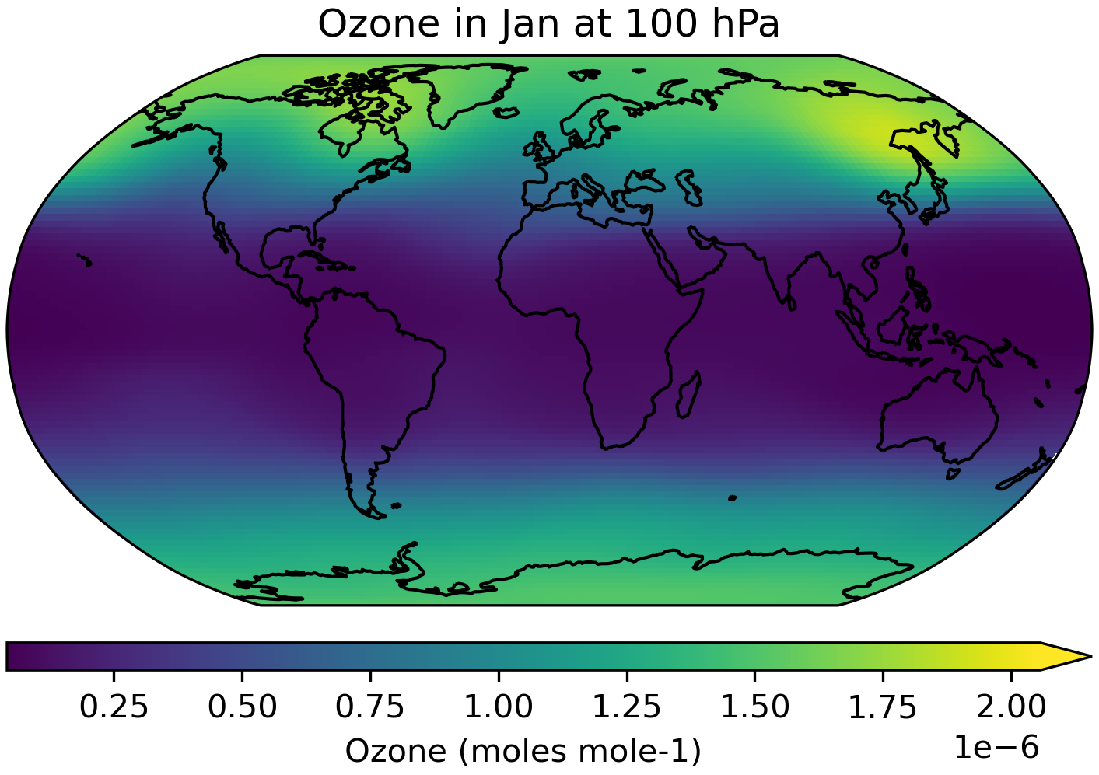
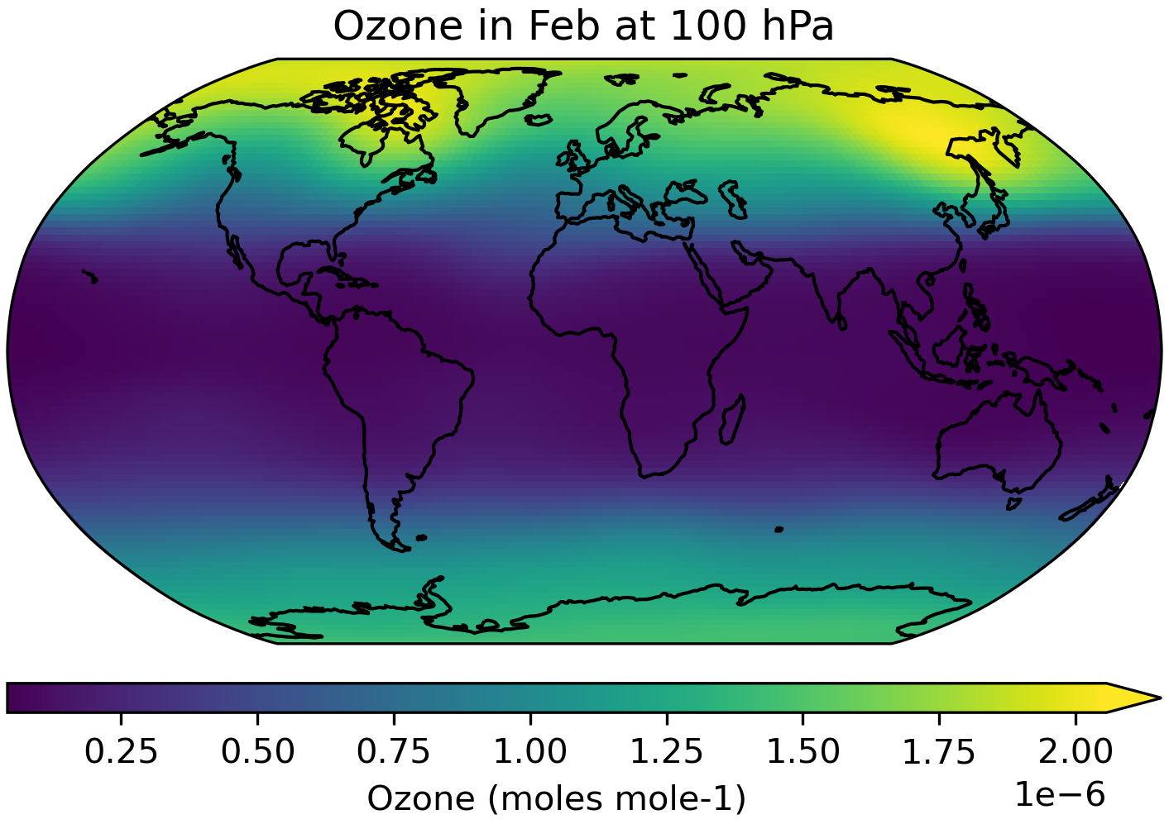
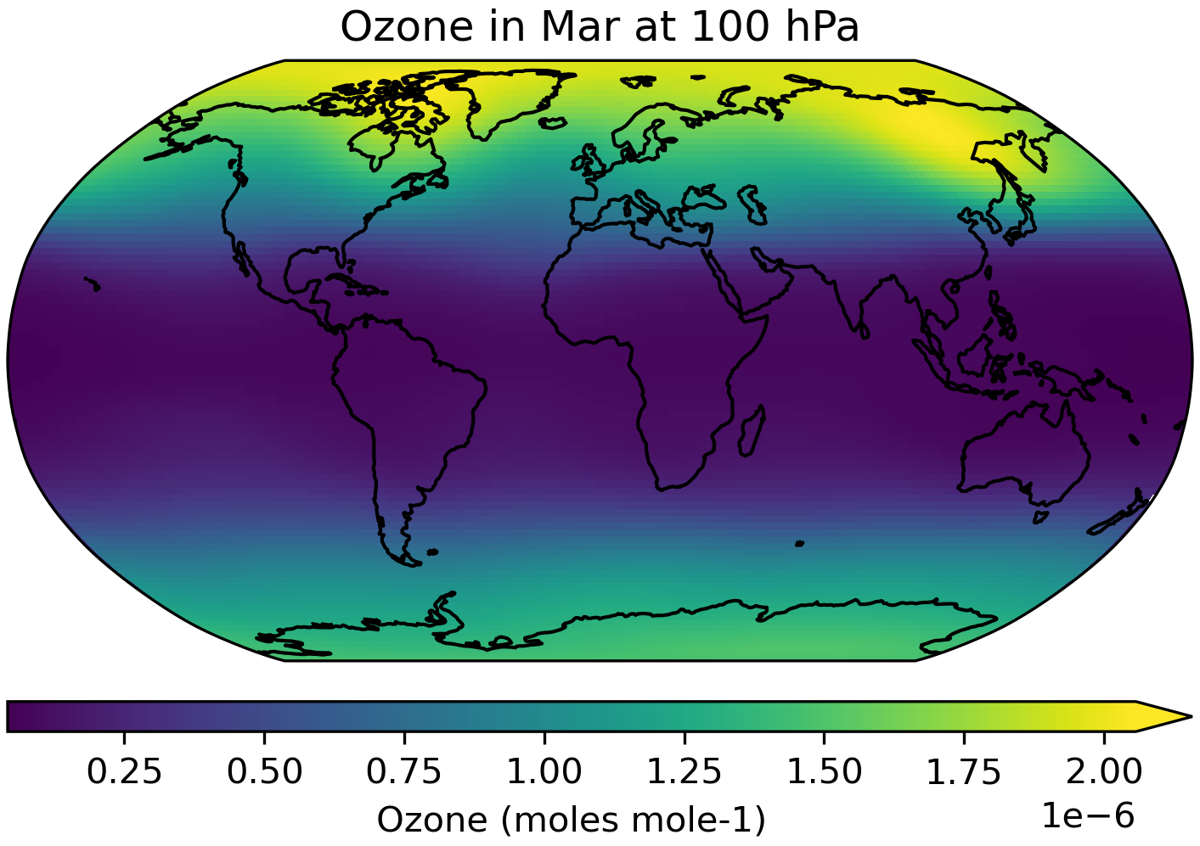
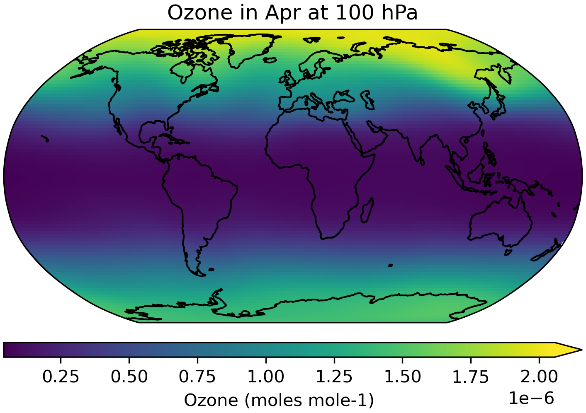
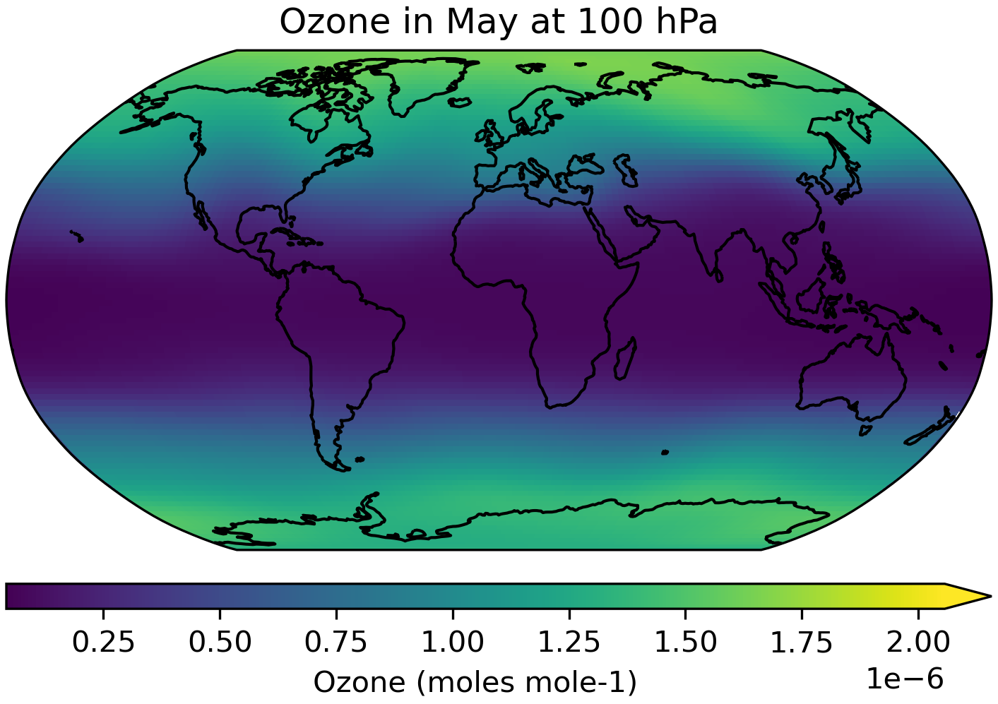
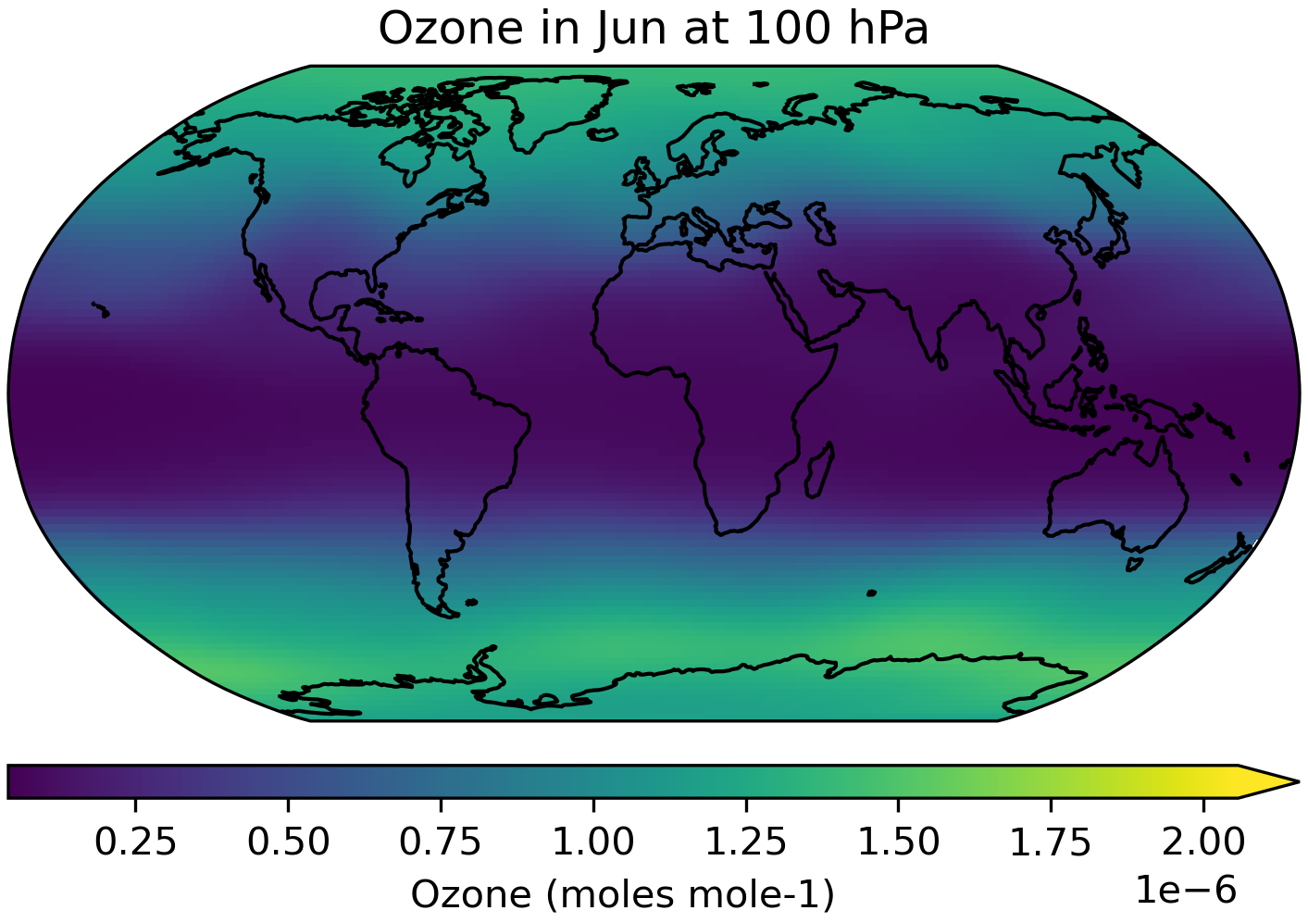
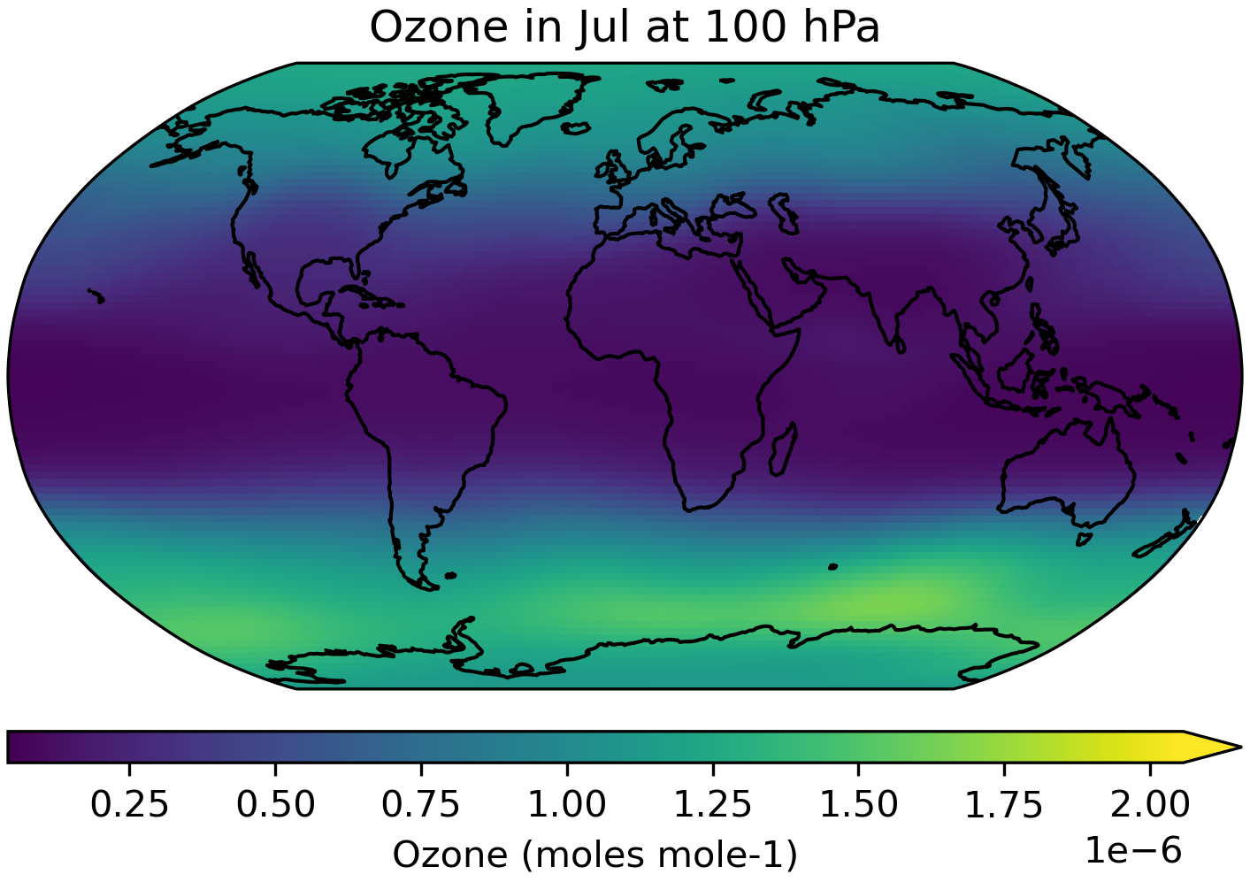
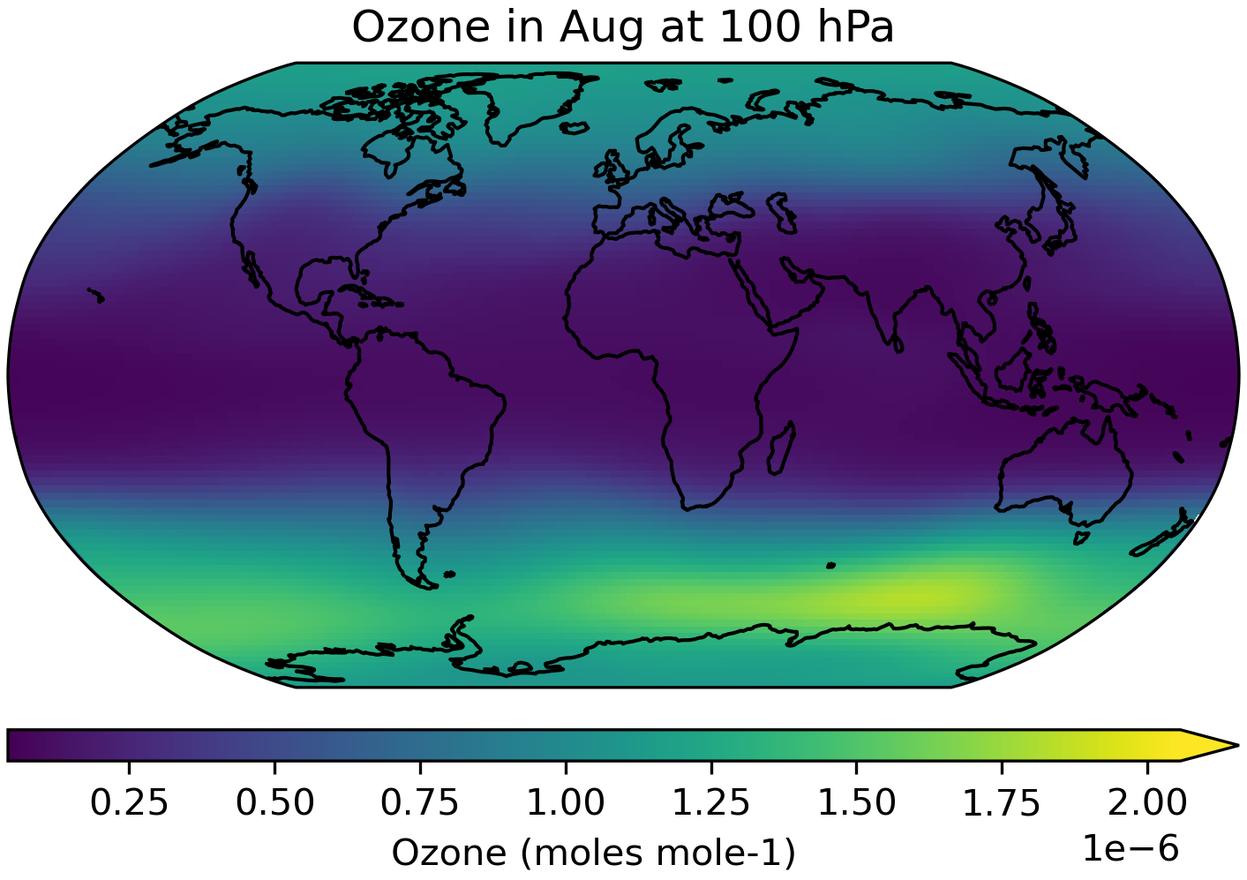
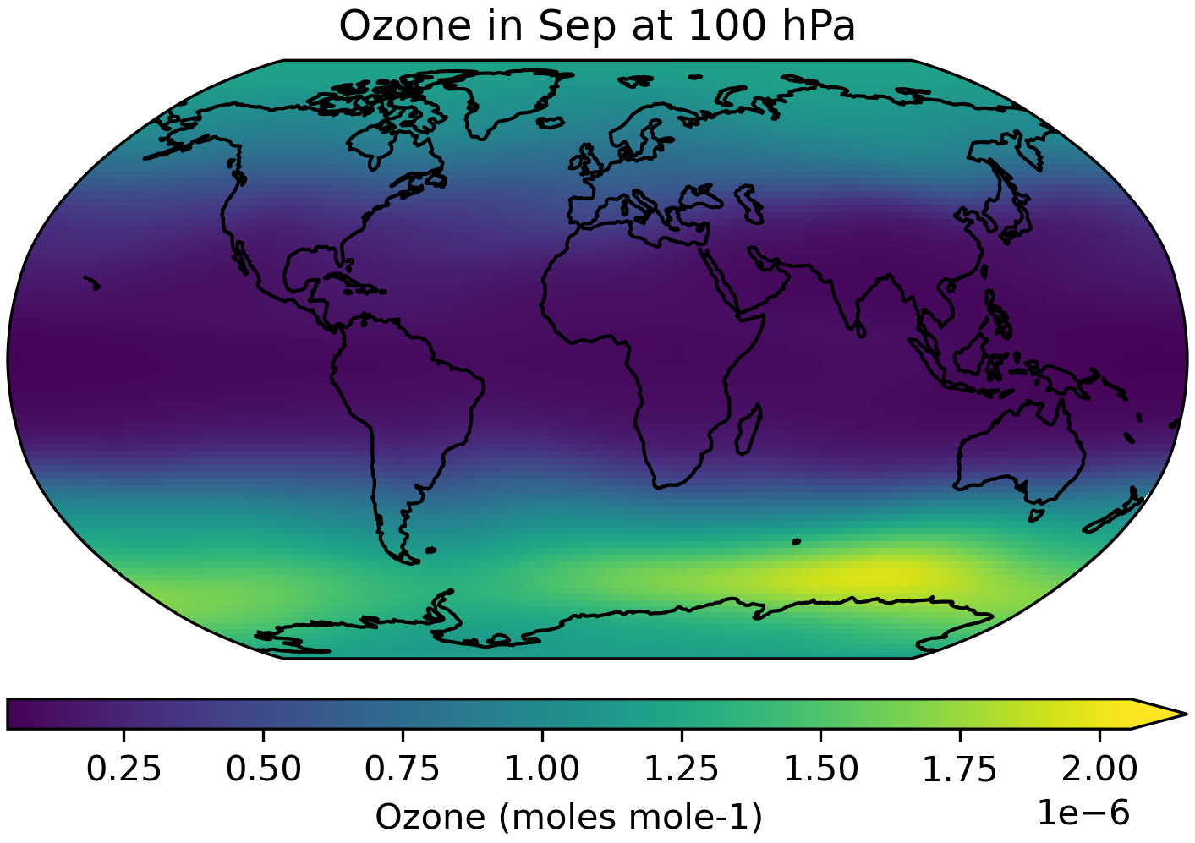
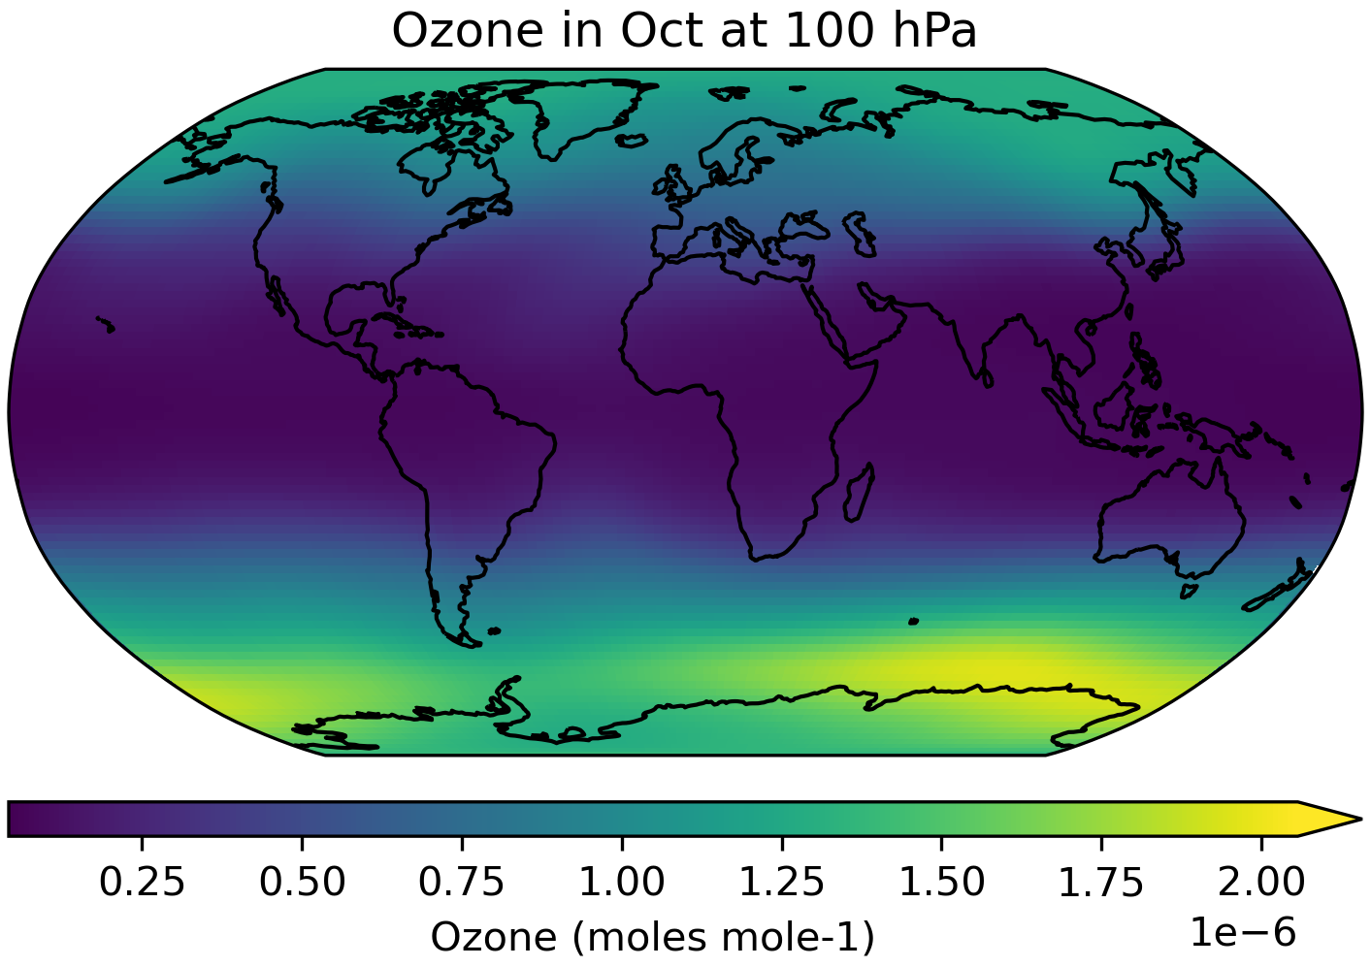
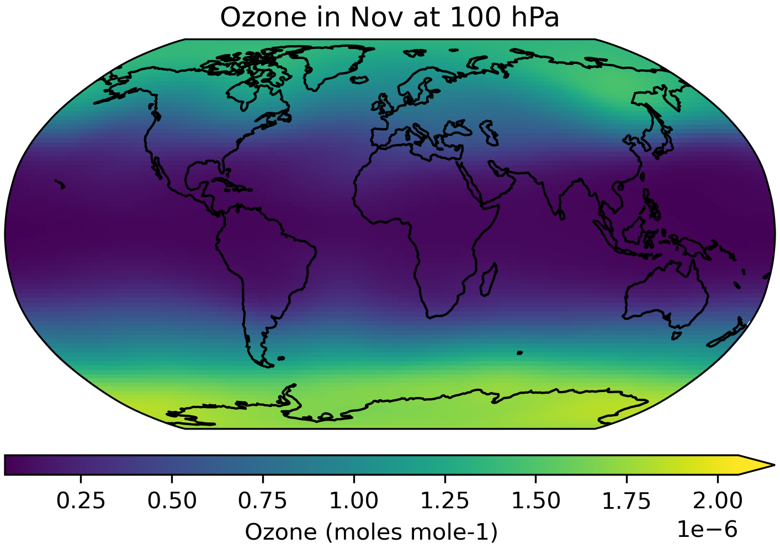
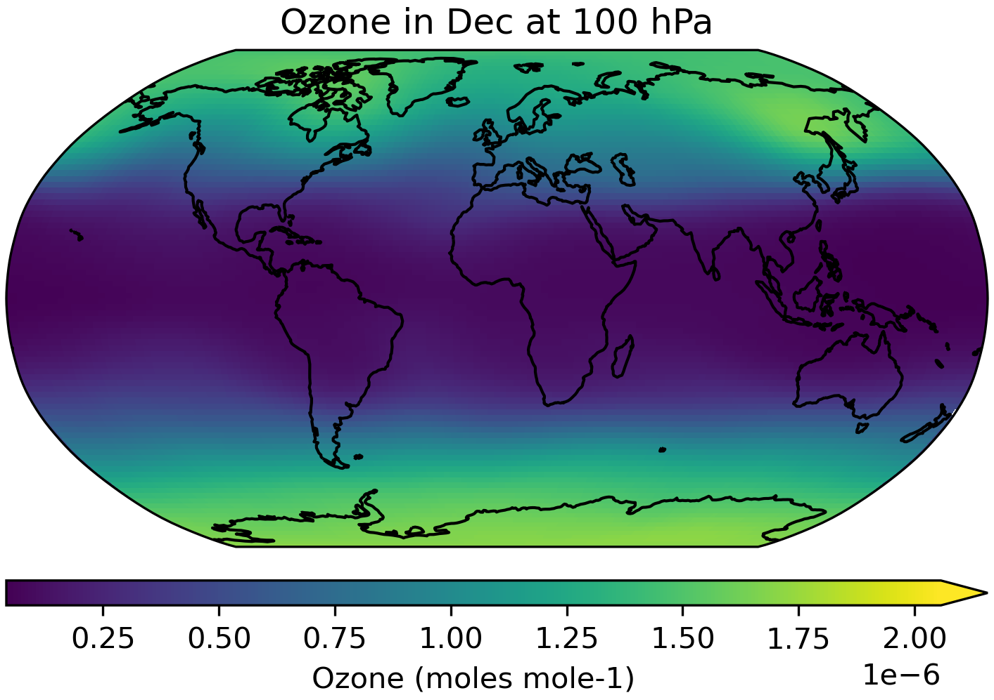
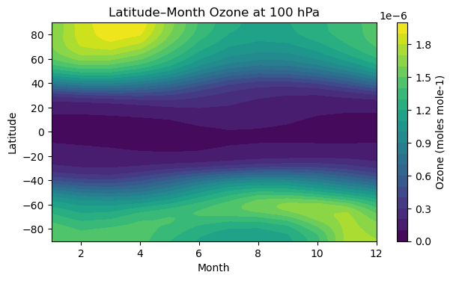
pi-Control ozone forcing climatology, 185001-185012
Original resolution

Slide 5
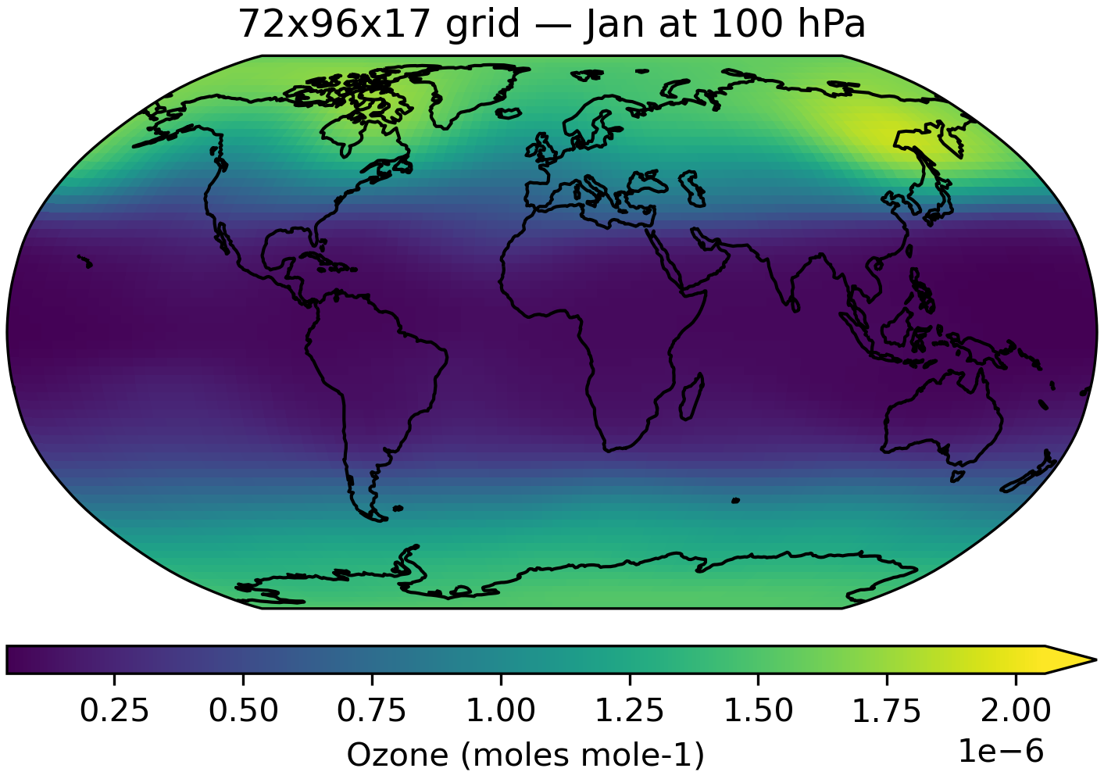
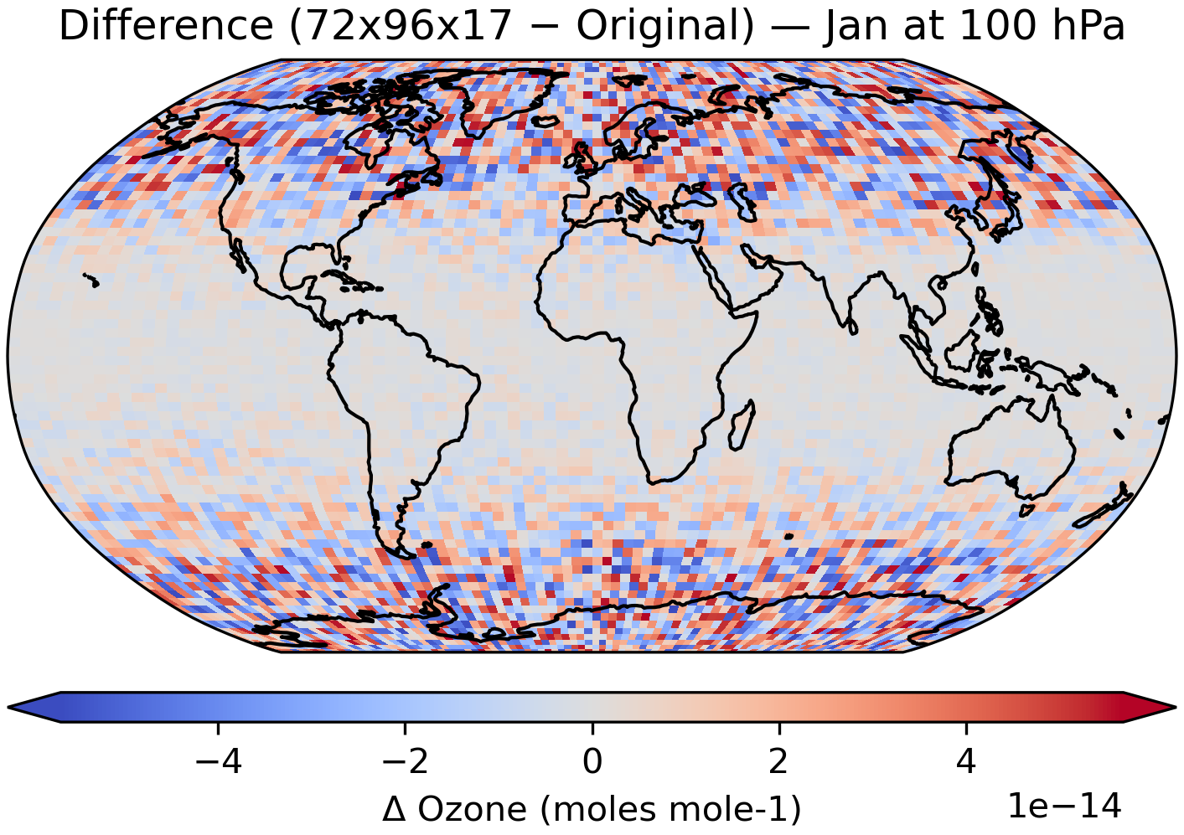
pi-Control ozone forcing climatology, 185001-185012
Original resolution
HadCM3B resolution
Bias: -5.414e-17 moles mole-1
RMSE: 1.799e-14 moles mole-1
Max |diff|: 5.682e-14 moles mole-1

Slide 6
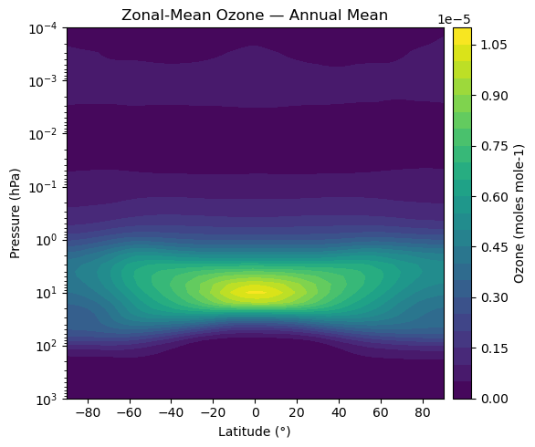
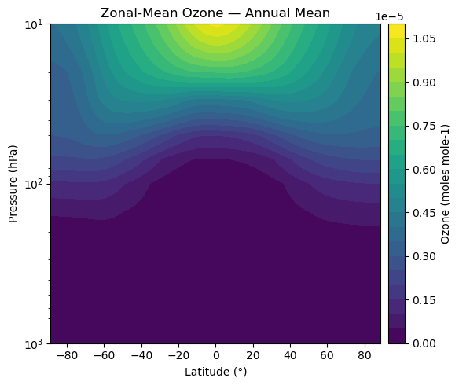
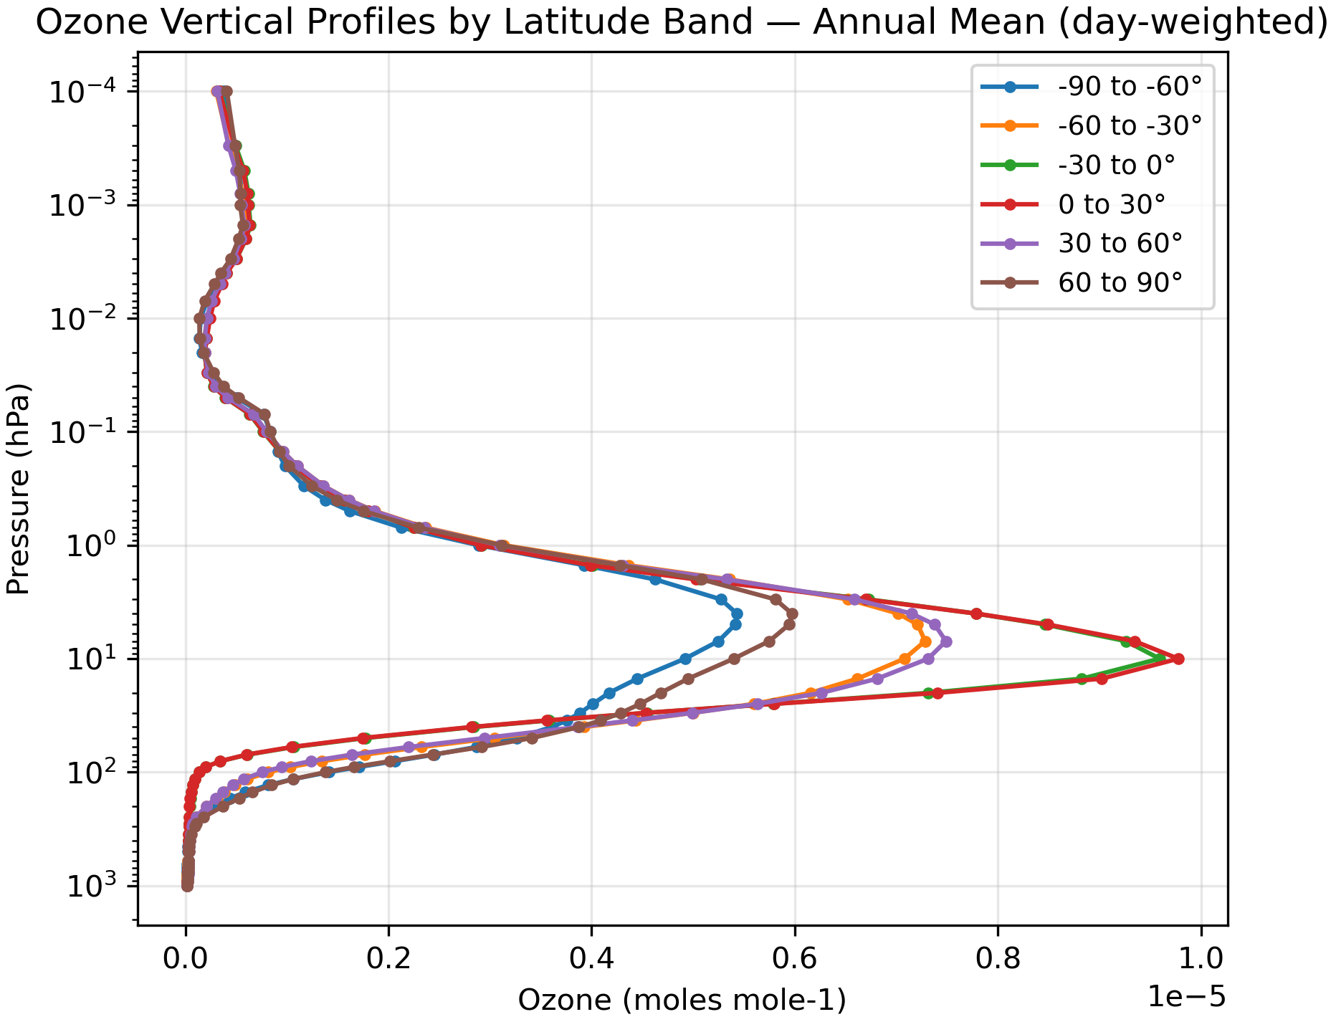
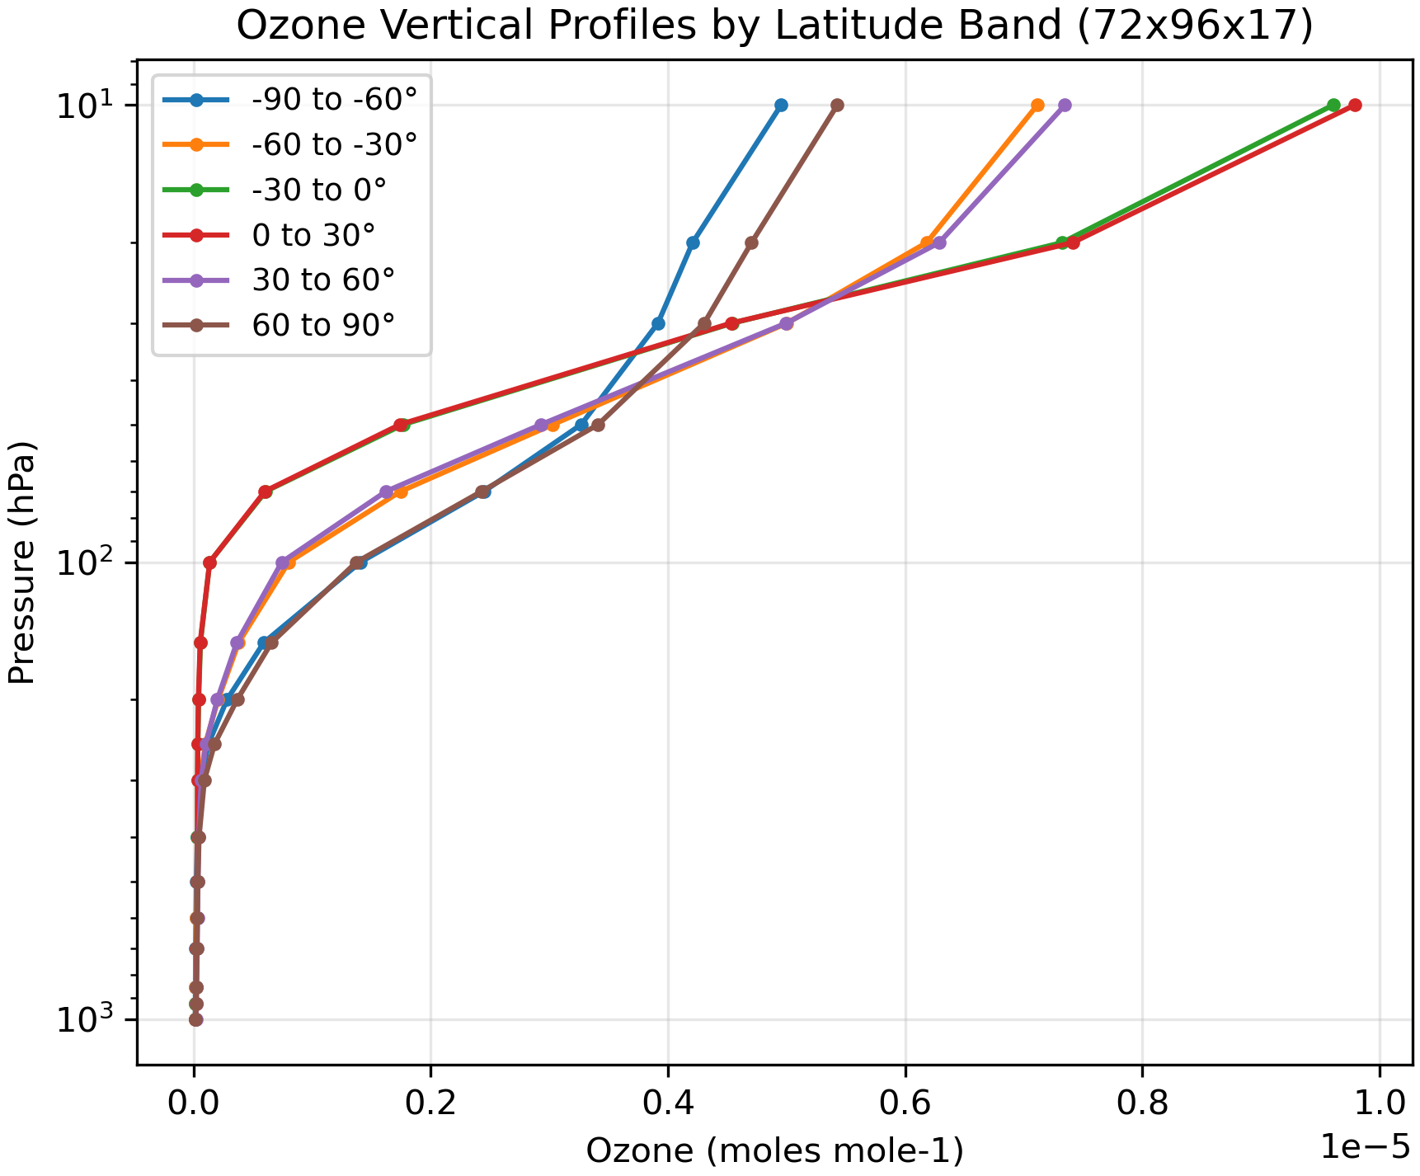
pi-Control ozone forcing climatology, 185001-185012
Original resolution
HadCM3B resolution
stratosphere
troposphere
troposphere

Slide 7
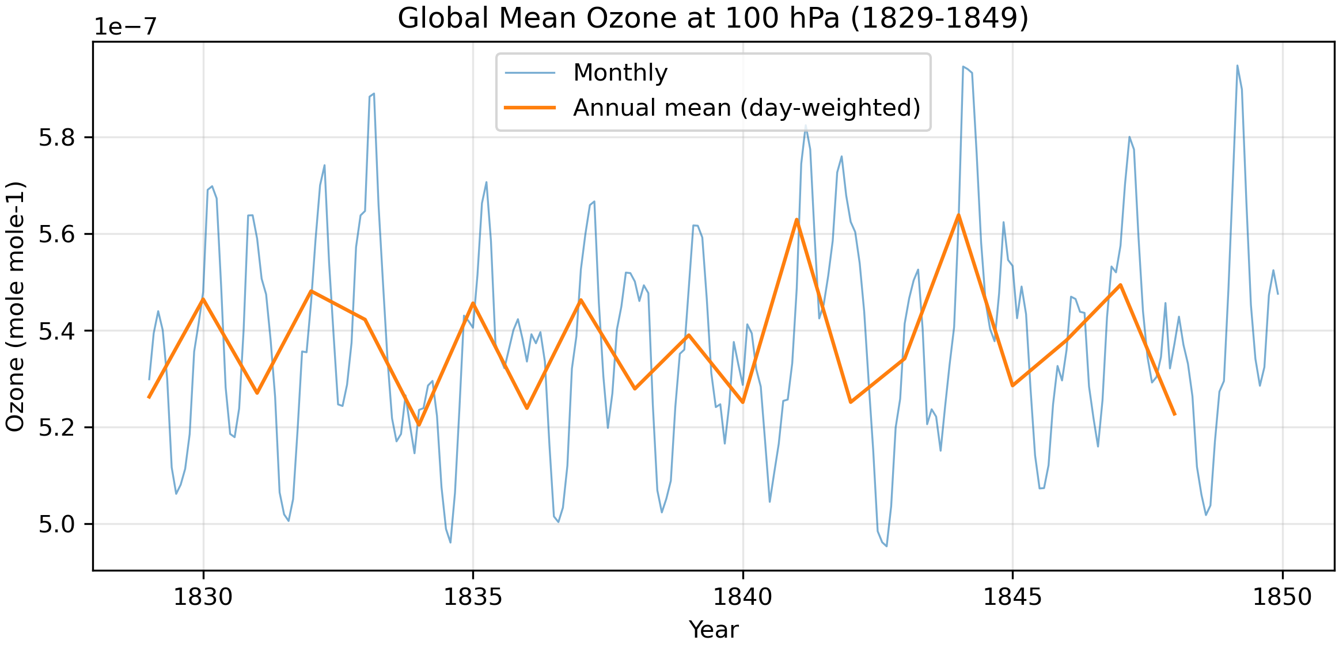
piControl transient ozone forcing
File name has time range equal to 182901-184912

Slide 8
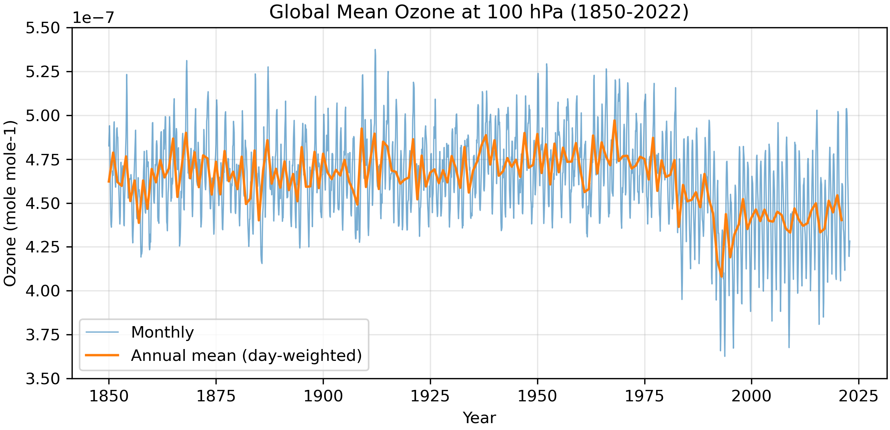
Historical transient ozone forcing
HadCM3B resolution

